Slide 1
Rakshatra
“A smart journey begins with a safe path”

Slide 2
PROBLEM STATEMENT
Travel has become easier than ever before.
Every day, millions of people travel to unfamiliar cities for tourism, education, work, or emergencies. The moment a traveler arrives in an unfamiliar place, several questions arise:
Which route should I take to reach my destination?
Is the driver offering me a fair price or am I being overcharged?
Should I take a metro, taxi, bus, or local transport?
Is this area safe to travel at night?
Who can I trust in an unfamiliar city?
What should I do if I face an emergency?
Travelers still struggle with transport confusion, safety uncertainty,
lack of trusted local services, and the risk of being exploited due to
unfamiliarity with the city.

Slide 3
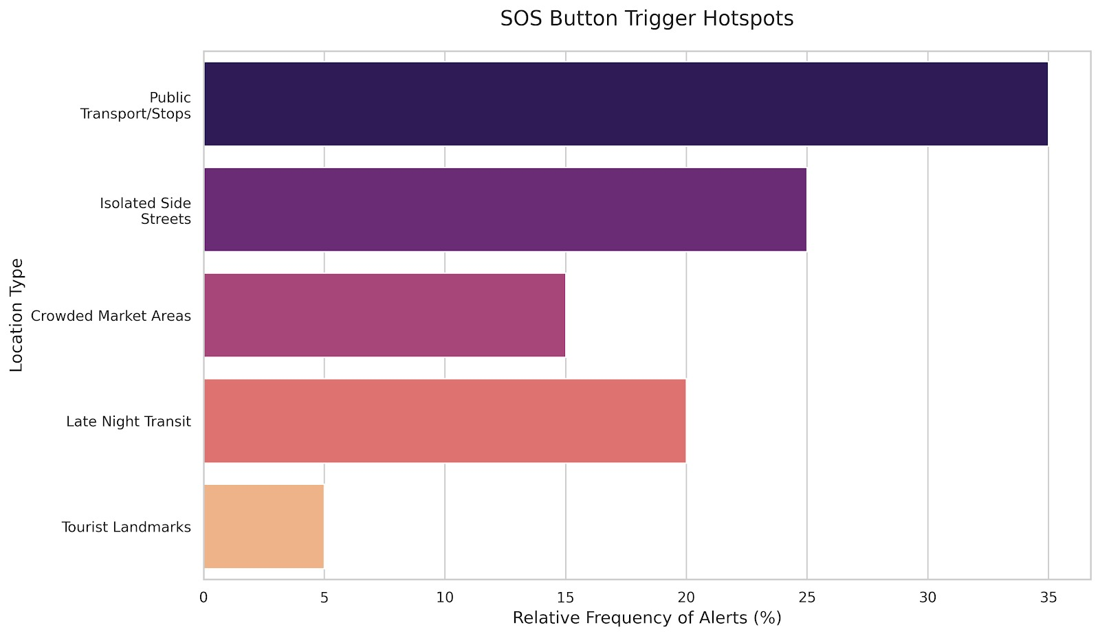
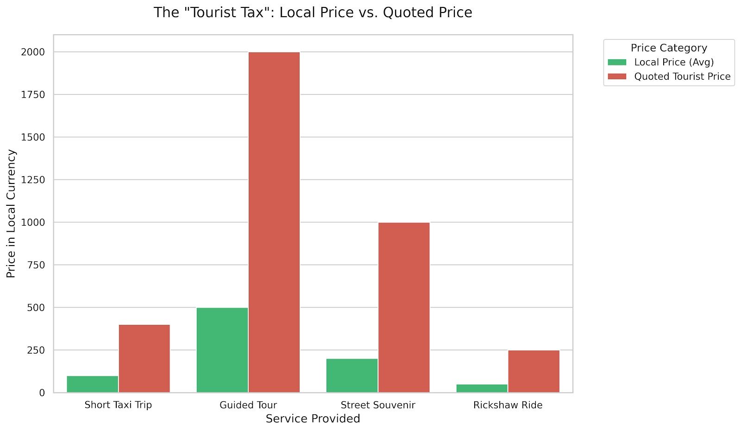
Statistical Representation of Problem
“These are not just minor inconveniences - they represent real risks that travelers face every day.”

Slide 4
Proposed solution:
We propose RAKSHATRA - a Smart Travel Safety Companion that helps people navigate unfamiliar cities safely, confidently, and efficiently.
RAKSHATRA brings together route intelligence, trusted services, and real-time safety support into one unified platform.
The system enables travelers to:
Plan smarter routes using metro, buses, taxis, and local transport combinations
Avoid scams with verified drivers and transparent fare estimates
Navigate safer paths with safety-aware route recommendations
Access instant help through a one-tap SOS emergency alert
Receive faster assistance through a nearby volunteer safety network
RAKSHATRA transforms fragmented travel tools into a single intelligent platform that prioritizes safety, trust, and smart mobility for travelers.

Slide 5
EXISTING SOLUTIONS
Competitor | Focus Area | Strengths | Weakness (Your Edge)
Google Maps / Apple Maps | Navigation & Mapping | Global Coverage: Unmatched mapping data, turn-by-turn navigation, and real-time traffic updates. | Navigation Only: Focuses only on routes No safety insights, scam detection, or verified last-mile transport guidance.
Uber / Ola / Rapido | Ride-Hailing & Transport | On-Demand Transport: Provides quick, point-to-point rides with integrated digital payment systems. | Single Transport Mode: Focuses only on rides, no integration with metro, buses, or trains.
Dedicated Safety Apps | Emergency Response | Quick Alerts: Provides immediate SOS triggers and location sharing with trusted contacts. | Reactive Safety: Helps after emergencies, not in preventing unsafe routes beforehand.

Slide 6
IMPACT
Beneficiary | The Problem | Rakshatra’s Impact
Solo / Women Travelers | Fear of unsafe streets and night travel. | AI-Safe Routing: Guides them through well-lit, populated areas with an active SOS.
Tourists | Overcharging scams and confusing public transit. | Financial Security: Provides transparent fare estimates and seamless transit links.
Verified Drivers | Honest drivers lose business to aggressive scammers. | Economic Trust: Drives fair business to vetted drivers based on user ratings.
Smart Cities | Tourists clog roads with cabs instead of using local transit. | Sustainable Mobility: Boosts public transit use by making it easy to navigate.

Slide 7
APPLICATIONS
1. Tourism & Travel Safety
Helps tourists explore unfamiliar cities safely with trusted routes, drivers, and emergency support.
2. Women Safety in Urban Travel
Provides safer route suggestions, emergency alerts, and rapid assistance during risky situations.
3. Smart City Mobility
Supports smart city initiatives by integrating multiple transport options into one intelligent platform.
4. Student & Professional Mobility
Useful for students and professionals relocating to new cities who need reliable travel guidance.
5. Emergency Assistance Network
Enables faster response during emergencies through location alerts and community volunteer support.

Slide 8
“Travel should create memories, not worries.”
- RAKSHATRA

