Slide 1
SCAN SPECTRUM
Theme : Open Innovation (SDG-Aligned)
Problem Statement Title : 2D to 3D.
Team Name : Scan Spectrum
Video link : https://drive.google.com/file/d/1b9FbMYgMkSOMl7dd8Djio9rUXkRhlIwR/view?usp=sharing

Slide 2
SCAN SPECTRUM
SCAN SPECTRUM
Problem Statement
Currently ,converting 2D images to usable 3D models requires manual modeling skills,hours of work ,specialized software.
Detailed explanation of the problem statement
The design and construction of 3d models requires high time and skill,software so to operate or work on the 3d models it require high skills and understanding.
Why it is relevant
To give a base for the 3d model generators and 3d printers.

Slide 3
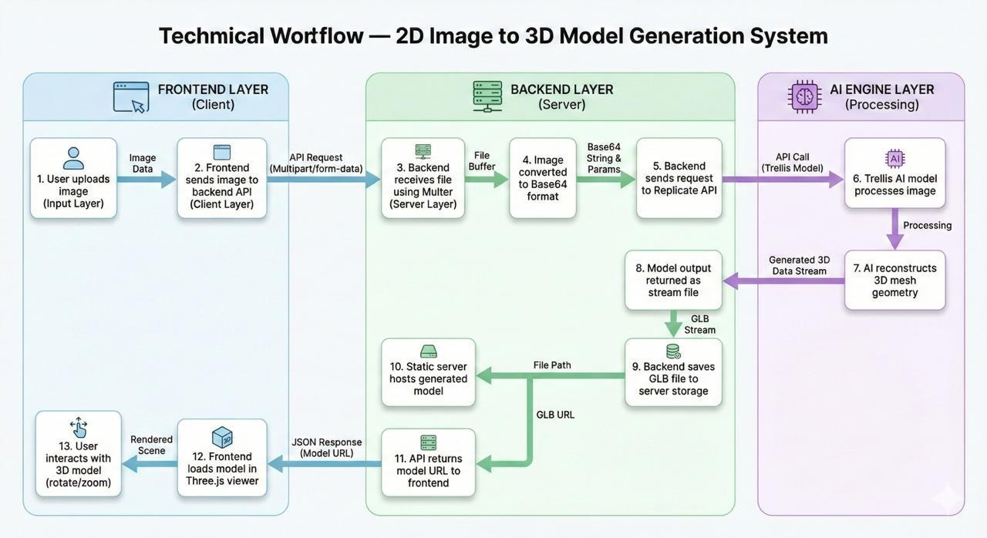
TECHNICAL APPROACH
SCAN SPECTRUM
FRONT END : HTML,CSS,JAVA SCRIPT
BACK END: NODE JS,EXPRESS JS
DEPLOYMENT: Git Hub for version control.
OTHER RESOURCES: Replicate,Postman.

Slide 4
Solution
SCAN SPECTRUM
Proposed solution
We built an AI-powered platform that converts a single 2D image into usable 3D models automatically
How your solution solves the problem
Our system creates new 3D models instead of just searching existing ones
Uniqueness of the solution: high quality meshed 3D models with maximum polygons

Slide 5
FEASIBILITY AND VIABILITY
SCAN SPECTRUM
Analysis of the feasibility of the idea:
Pre trained AI APIs and modular backend architecture which make our solution scalable, real world application.
Potential challenges and risks.
Latency and variable quality.
API and large model dependency risks.
Strategies for overcoming these challenges:
Boost Performance
Increase reliability

Slide 6
RESEARCH AND REFERENCES
SCAN SPECTRUM
Replicate — Used for accessing pretrained generative AI models via API.
Trellis 3D Model — Image-to-3D reconstruction research and inference frameworks.
Three.js Documentation — WebGL-based 3D rendering and visualization.
Official documentation of Node.js, Express, and WebGL for backend and rendering implementation standards.

