Slide 1
HOMOMORPHIC ENCRYPTION BASED VIDEO COPY DETECTION IN MULTI VIEW VIDEOS STORED IN A CLOUD

Slide 2
Abstract
The rapid proliferation of multimedia content and the increasing adoption of cloud storage have led to growing concerns over unauthorized duplication and distribution of video content. This issue becomes particularly complex with multi-view videos, which offer multiple perspectives of the same scene and are frequently used in surveillance, entertainment, and immersive experiences. Ensuring the integrity and ownership of such content requires robust and privacy-preserving mechanisms. This project proposes a novel framework for detecting video copies in a multi-view environment while maintaining the confidentiality of the data using homomorphic encryption.

Slide 3
Introduction
The widespread use of cloud services and the exponential growth in multimedia content creation have revolutionized how videos are stored, shared, and consumed globally. With increasing internet penetration and the emergence of advanced camera technologies, multi-view videos—videos captured simultaneously from different angles—are becoming more prevalent in domains such as surveillance, virtual reality, telemedicine, and entertainment. While these developments offer enhanced user experiences and broader application scopes, they also raise serious concerns regarding unauthorized duplication, content piracy, and intellectual property violations.

Slide 4
literature survey
1. Title: A Secure and Privacy-Preserving Video Surveillance System Using Homomorphic Encryption
Authors: Zhang, H., Wang, C., & Yu, S.
Description Points:
Proposed a privacy-preserving video surveillance framework using Fully Homomorphic Encryption (FHE).
2. Title: Robust Video Copy Detection Using Spatio-Temporal Features
Authors: Chen, L., Wu, F., & Li, H.
Description Points:
Developed a video fingerprinting method based on spatio-temporal interest points.

Slide 5
Existing System
In the current digital landscape, various systems have been developed to detect unauthorized video copies. These systems primarily rely on content-based video retrieval (CBVR) techniques and digital video fingerprinting. The typical workflow involves extracting unique, representative features from video files and comparing them to features stored in a database to identify duplicates or near-duplicates. While effective in controlled scenarios, existing systems exhibit significant limitations when applied to modern, complex environments such as multi-view video repositories in the cloud.

Slide 6
Drawbacks
High Computational Overhead
Homomorphic encryption, while secure, introduces significant computational overhead. Performing encrypted-domain operations such as similarity matching can be slow, especially for large video datasets, impacting real-time detection performance.
Storage Requirements
Encrypted feature vectors are typically larger in size than their plaintext counterparts. This increased data size can lead to higher cloud storage costs and may require more robust data management strategies.

Slide 7
Proposed System
To overcome the limitations of existing video copy detection systems, this project proposes a Homomorphic Encryption Based Video Copy Detection System specifically designed for multi-view videos stored in a cloud environment. The goal is to provide a secure, privacy-preserving, and efficient framework that can detect duplicate or pirated video content without exposing the original data to unauthorized parties, including cloud service providers.The core innovation of the proposed system lies in the use of homomorphic encryption (HE), which enables computations to be carried out on encrypted data..

Slide 8
Advantages
End-to-End Privacy Preservation
  The use of homomorphic encryption ensures that video features are never exposed in plaintext, maintaining complete confidentiality of user data throughout the copy detection process.
  Even cloud providers or system administrators cannot access the original video content.
Secure Computation in Encrypted Domain
  Enables matching and comparison operations directly on encrypted features, eliminating the need for decryption during analysis.
  Ensures zero knowledge processing, which significantly reduces the risk of data breaches.

Slide 9
HARDWARE REQUIREMENTS:
System : i3
Hard Disk : 250 GB
RAM : 4 GB

Slide 10
SOFTWARE REQUIREMENTS:
Operating system : Windows Family
Coding Language : Python

Slide 11
Modules
Data Collection Module
Data Preprocessing Module
Feature Extraction using Pre-trained Models
Ensemble Classification Module
Prediction and Result Display Module
Model Evaluation Module

Slide 12
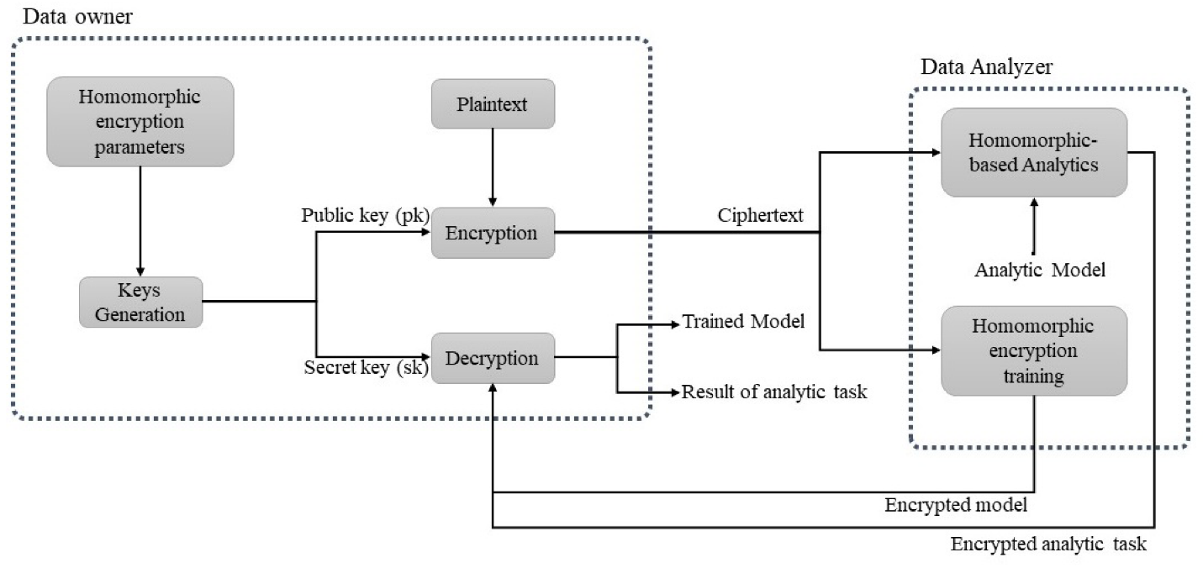
System Architecture:

Slide 13
UML
Class Diagram:

Slide 14
Use case Diagram:

Slide 15
Sequence Diagram:

Slide 16
Collaboration Diagram:

Slide 17
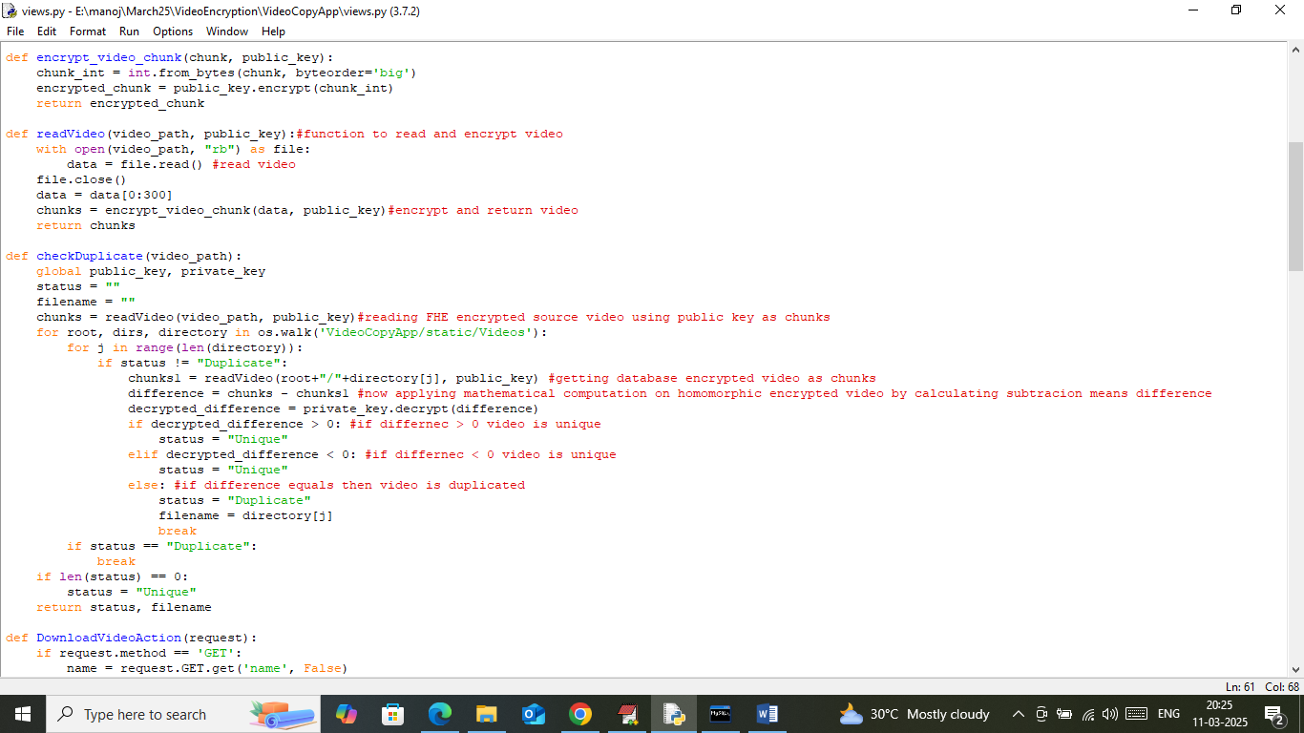

Slide 18
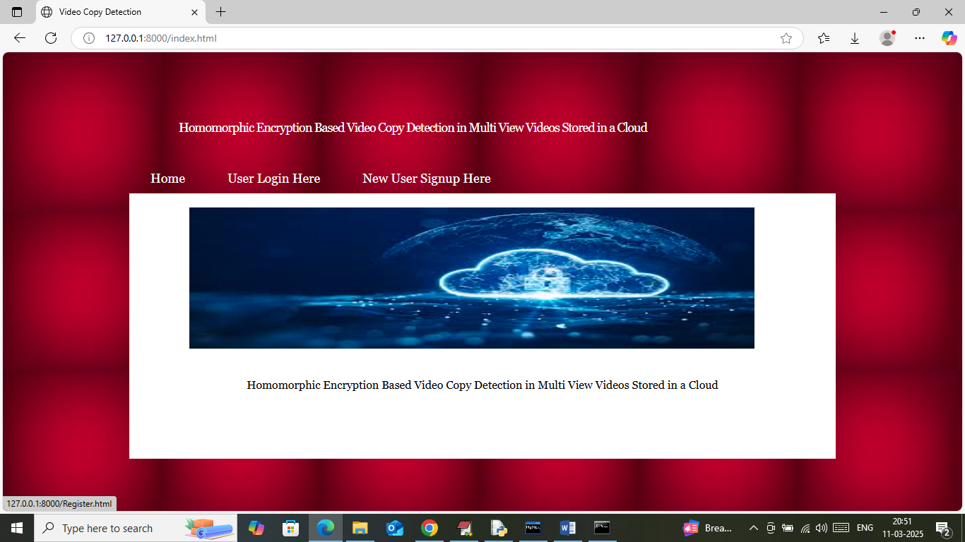

Slide 19


Slide 20
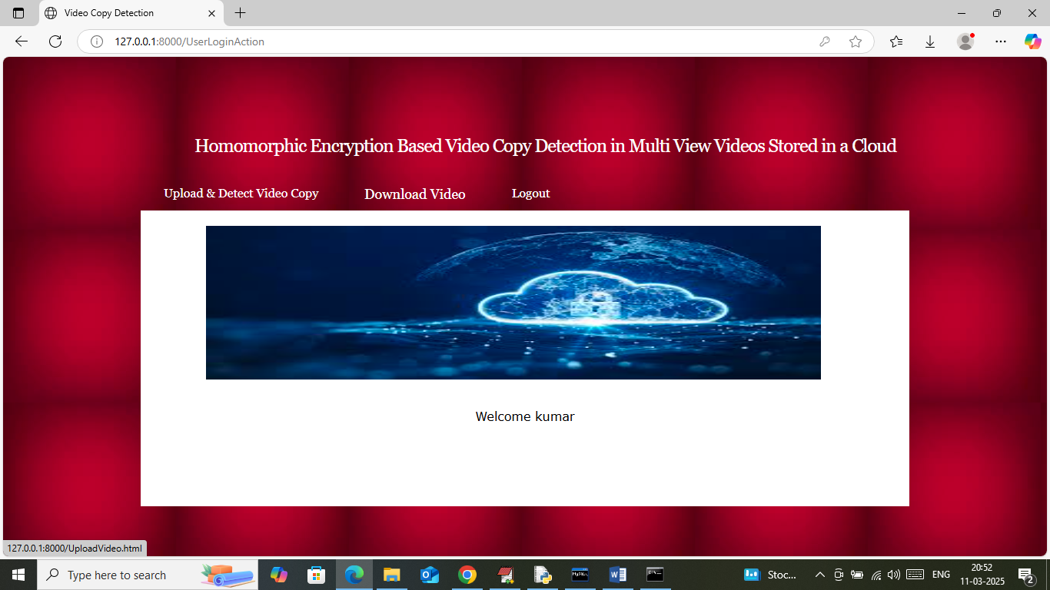

Slide 21
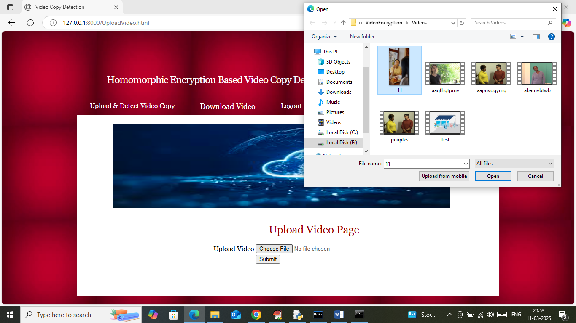

Slide 22
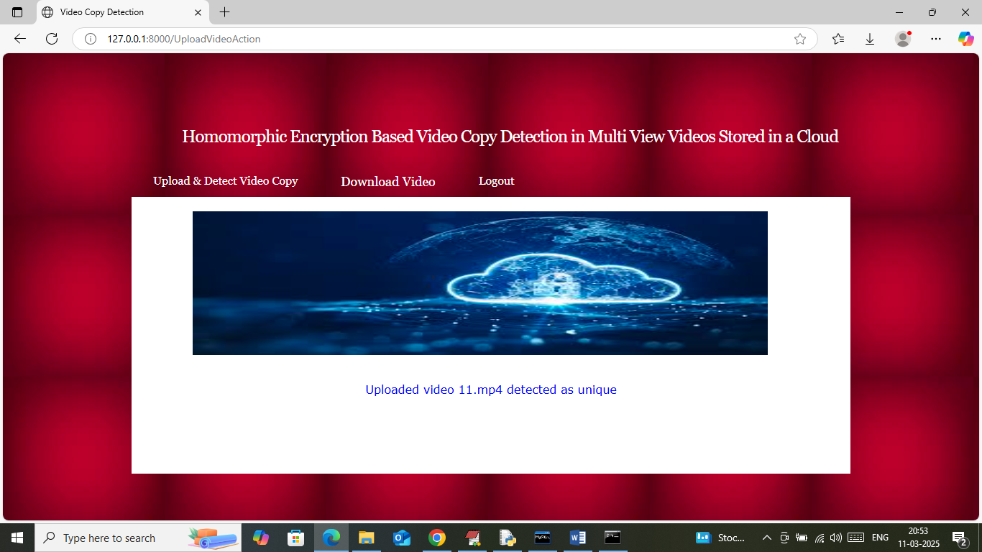

Slide 23
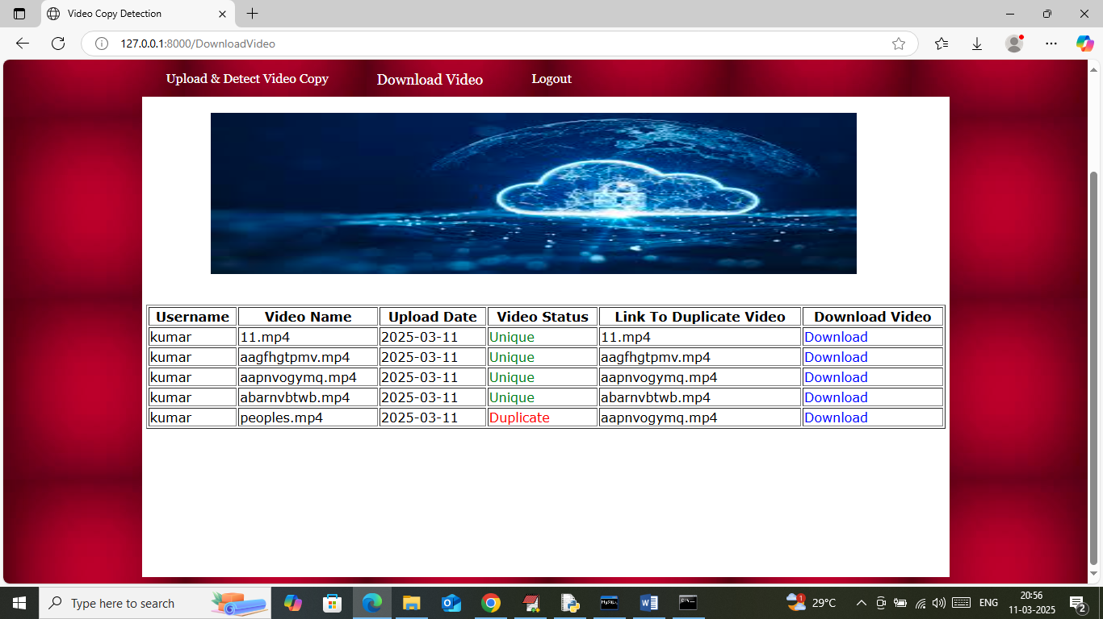

Slide 25
Conclusion
This project presents a novel approach to video copy detection by integrating homomorphic encryption with advanced view-invariant feature extraction techniques, tailored for multi-view videos stored in cloud environments. By enabling secure computations directly on encrypted data, the proposed system effectively addresses privacy concerns that traditional copy detection methods fail to resolve. The system ensures that sensitive video content remains confidential throughout the detection process, even when hosted on untrusted cloud platforms.

Slide 26
Future work
While the proposed system demonstrates strong capabilities in secure video copy detection, there are several avenues for further improvement and expansion. Future work could focus on optimizing the computational efficiency of homomorphic encryption operations, which currently impose significant overhead on processing times. Research into lightweight or approximate homomorphic encryption schemes may help balance security with real-time performance demands.Another promising direction is the integration of advanced machine learning models, such as transformer-based architectures or graph neural networks, to enhance the extraction of more discriminative and compact features from multi-view videos.

Slide 27
Reference
Gentry, C. (2009). A Fully Homomorphic Encryption Scheme. Stanford University.
Brakerski, Z., Fan, J., & Vercauteren, F. (2012). Fully Homomorphic Encryption without Bootstrapping. In Advances in Cryptology – ITCC.
Cheon, J. H., Kim, A., Kim, M., & Song, Y. (2017). Homomorphic Encryption for Arithmetic of Approximate Numbers. In ASIACRYPT.
Microsoft SEAL (release 3.6). https://github.com/microsoft/SEAL
Yu, H., Chen, L., & Wang, L. (2020). Privacy-Preserving Multimedia Content Copy Detection Based on Homomorphic Encryption. IEEE Transactions on Information Forensics and Security, 15, 1232-1243.

Slide 28
THANK YOU

