Slide 1
PARKING SLOT BOOKING SYSTEM

Slide 2
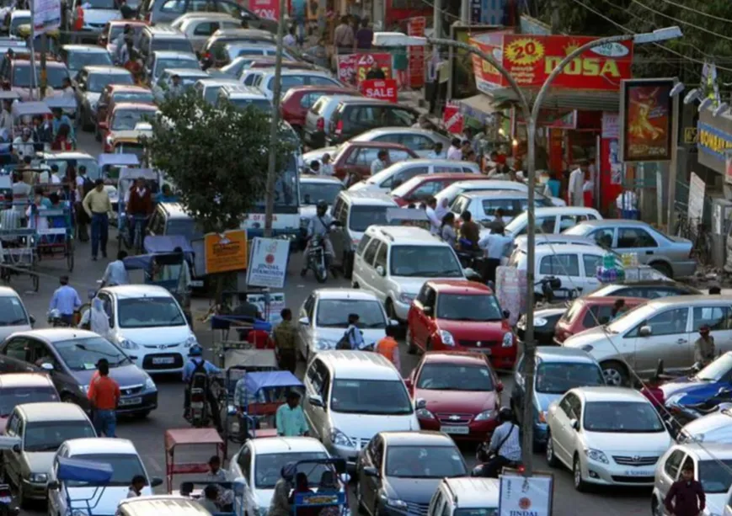
S-PARK : IoT-Enabled Real-Time Parking Booking System
THE PROBLEM STATEMENT:
The Reality: Rapid urbanization has dramatically increased vehicle density, yet parking infrastructure remains static and disconnected. Drivers in metro cities waste valuable time and fuel merely "circling" to find open spaces, creating a cycle of congestion and pollution that chokes city streets.
The Failures:
Blind Navigation: Existing systems lack real-time slot availability, forcing drivers to rely on luck rather than data.
Manual Bottlenecks: The reliance on manual attendants and physical tokens creates slow entry/exit queues that cannot scale during peak hours.
Inefficient Allocation: High-demand spaces remain unmonetized while drivers struggle to find parking nearby.
Drivers in Indian metros waste nearly 7 days a year searching for
slots, a struggle that directly fuels 30% of total urban traffic congestion (BCG & Uber Study). This crisis is accelerating annually as 20 million new vehicles hit the roads, overwhelming infrastructure that cannot keep pace.

Slide 3
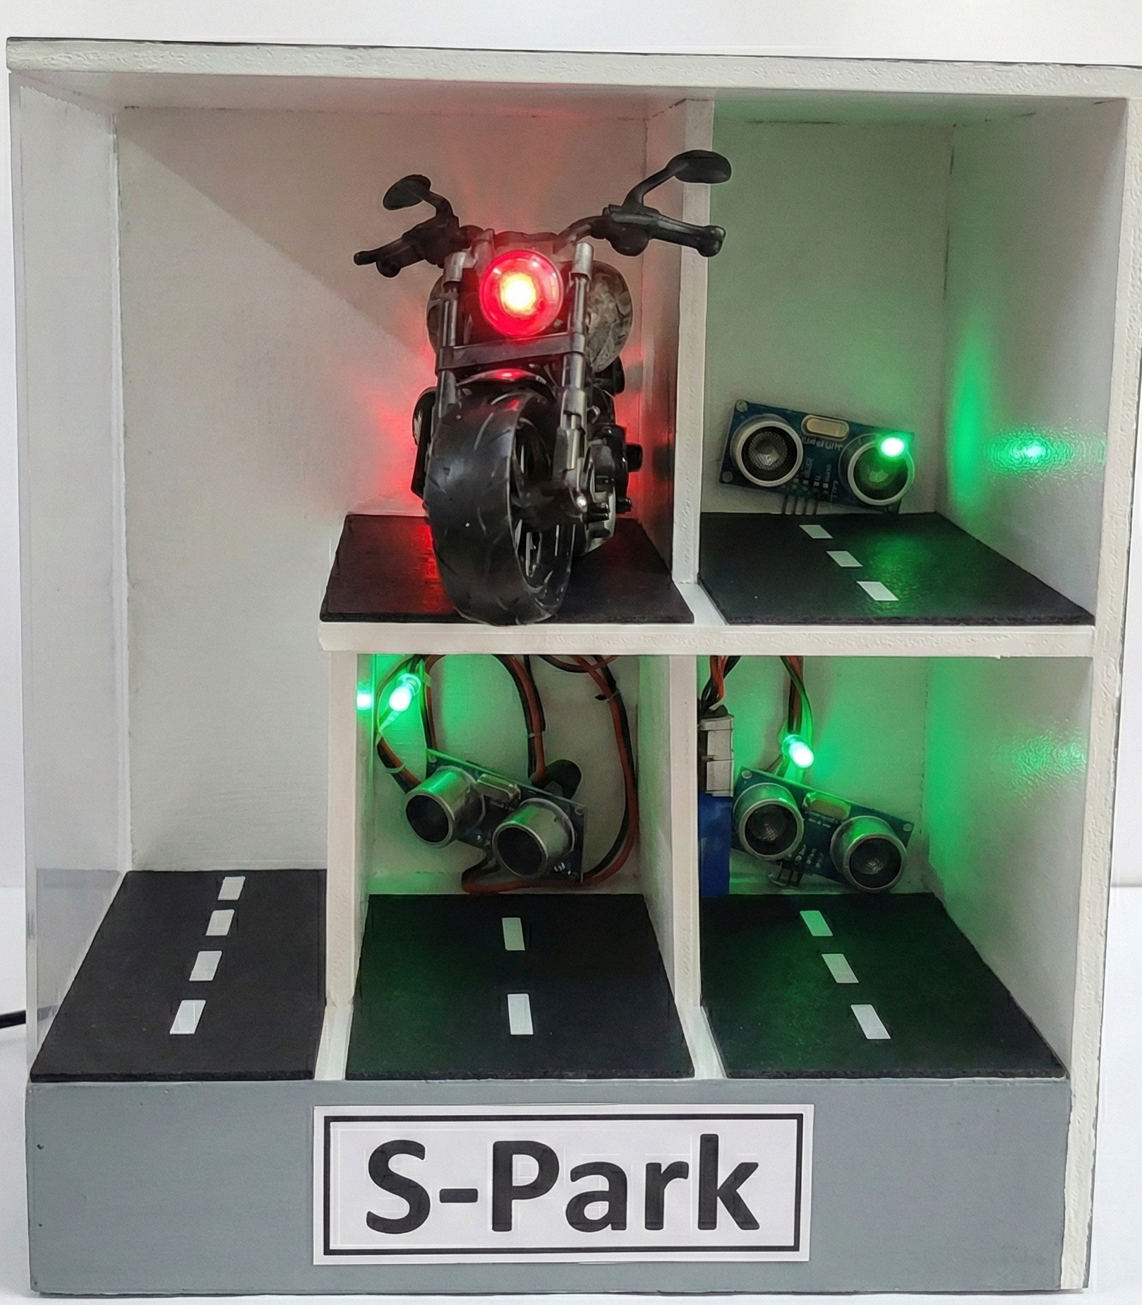
S-PARK : IoT-Enabled Real-Time Parking Booking System
The S-Park Solution: focusing on the "Gold Standard" automation and efficiency components we discussed:
a. Precision Occupancy Detection: Ultrasonic sensors and ESP32s deliver instant, interference-free status updates to eliminate manual checking delays.
b. Anti-Ghosting Validation Logic: Timer-based monitoring auto-cancels bookings after three failed alerts to prevent artificial scarcity.
c. Intelligent Rerouting Algorithm: A dynamic engine instantly recommends nearby alternatives if the selected slot is fully booked.
d. End-to-End Automation: Seamless integration triggers status updates and fee calculations automatically upon entry and exit.
e. Real-Time Cloud Sync: High-frequency HTTP transmission ensures the app reflects ground reality with sub-second latency.

Slide 4
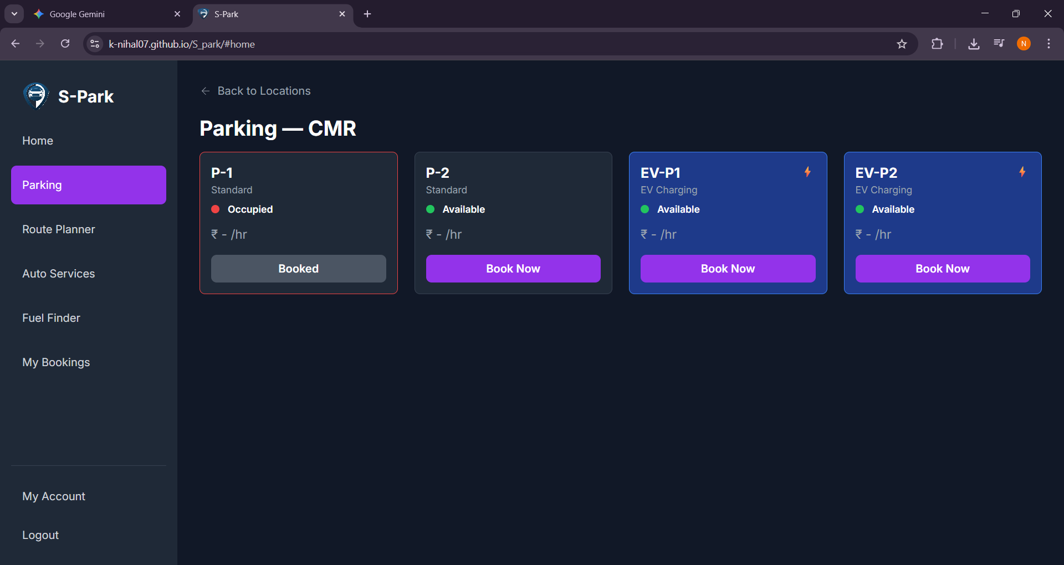
S-PARK : IoT-Enabled Real-Time Parking Booking System
Current status of the Technology
Core Function: A functional prototype that uses ultrasonic sensors to detect the presence of a vehicle in
a single parking slot and updates the status in real-time on a server.
Slot Operations: The system correctly identifies "Occupied" and "Vacant" states. A basic validation timer
is implemented to detect no-shows after a booking is made.
Tech Stack: Built using an ESP32 microcontroller interfaced with HC-SR04 ultrasonic sensors. Data is transmitted via Wi-Fi to a Firebase/AWS IoT Core backend for status storage.
Data Output: Real-time slot availability is displayed on a simple web dashboard. Booking logs and sensor data are stored in a cloud database
Validation: Detecting vehicle arrival with the sensor, and automatically updating the slot status, proving the core concept's viability.
Video Link: https://drive.google.com/file/d/1pbAs4ekpuDeP2GhdtvPFr90S5XoX_y4U/view?usp=drive_link

Slide 5
S-PARK : IoT-Enabled Real-Time Parking Booking System
Current Prototype vs. Future Product
Feature | CURRENT PROTOTYPE | FUTURE PRODUCT (TRL 9)
Sensing Technology | Ultrasonic Sensors (HC-SR04) | AI-Powered Cameras (ANPR & Object Detection)
Processing Unit | Single ESP32 Microcontroller | Distributed Edge AI Computing (e.g., Jetson Nano)
Booking Validation | Basic Timer-Based | Multi-Factor (Timer + Camera Visual Confirmation)
User Interface | Basic Web/Mobile Dashboard | Full-Featured App with Navigation & Payments
Scalability | Single Slot / Small Cluster | Multi-Level, Multi-Location Cloud Architecture
Additional Services | None | Integrated EV Charging & Dynamic Pricing

Slide 6
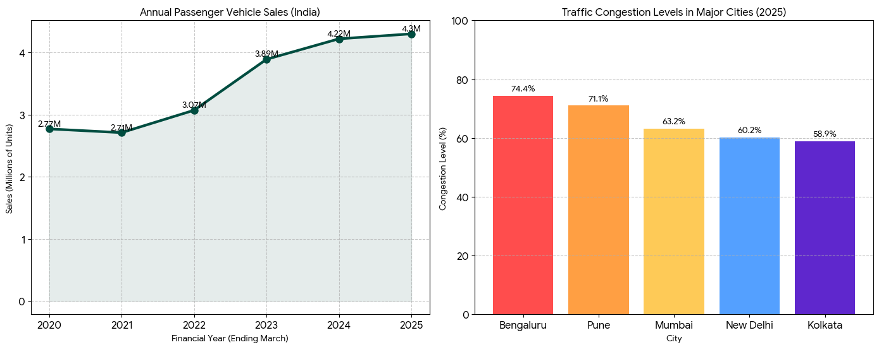
Market Potential
The Smart Parking Boom: India’s market is projected to surge from $289M to $882M by 2033, growing at a massive 13.2% CAGR.
Government Drivers: The Smart Cities Mission is investing over ₹1.64 lakh crore, actively funding tech-driven solutions for urban decongestion.
Critical Demand: With 4.30 million new vehicles added annually to Indian roads, the "space crunch" is creating an urgent need for automated management.
Strategic Opportunity: We target the 30% of total city traffic caused purely by parking searches, placing us exactly where "High Growth Tech" meets "Urban Necessity."

Slide 7
Indian Competitors (Alternate Technologies)
Competitor | Focus Area | Strengths | Weakness (Your Edge)
Park+ | Residential & Corp. Security | Super App Ecosystem: Massive retention via integrated FASTag, car wash, and insurance services. | Hardware Heavy: Relies on RFID/Barriers in gated societies; less effective for open, unstructured public parking.
ValetEZ | Valet Parking Automation | Mall/Station Dominance: "Valet-on-Demand" model removes the parking hassle entirely for premium users. | Manpower Dependent: Relies on human drivers (valets), making it harder to scale than your fully automated sensor system.
Get My Parking | B2B Smart City Platform | Interoperability: "Plug-n-Play" retrofitting allows them to upgrade old equipment without replacing it. | No Consumer Brand: They sell software to operators, lacking a direct app for drivers to quickly book a spot on the fly.

Slide 8
Global Competitors
Competitor | Focus Area | Strengths | Weakness (Your Edge)
JustPark (UK) | Private Driveway Rentals | Unlock Hidden Supply: Allows homeowners to rent out driveways, vastly increasing inventory. | No Real-Time Validation: Lacks sensors, leading to disputes if a "booked" driveway is blocked by another car.
SpotHero (USA) | Garage Yield Management | Dynamic Pricing: Sophisticated AI adjusts rates based on demand to maximize revenue. | Aggregator Only: They sell digital tickets but don't control the physical ground sensors, risking "ghost" bookings.
AppyParking (UK) | On-Street Compliance | High-Def Mapping: Digitizes curbside rules (Red/Yellow lines) to show legal parking spots. | Costly Maintenance: Requires constant, expensive re-mapping of cities to keep data accurate.

Slide 9
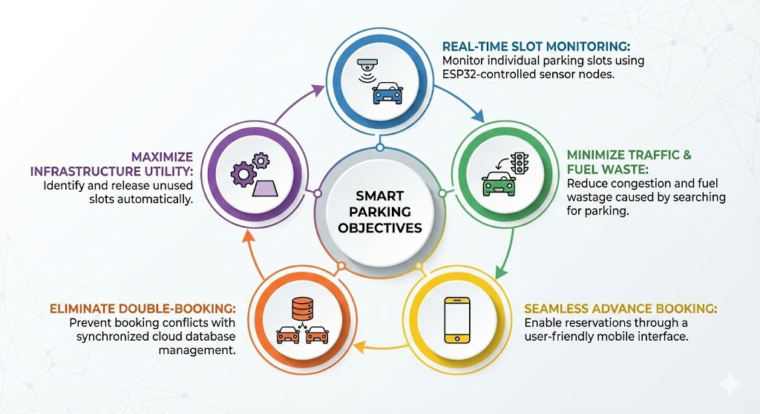
Aim:
To design and deploy a Smart IoT-Based Parking Management System
Objectives:
Aim & Objectives
Maximize parking infrastructure utility by identifying and releasing unused slots automatically
Monitor individual parking slots in real-time using ESP32-controlled sensor nodes.
Minimize urban traffic congestion and fuel wastage caused by drivers searching for parking.
Enable seamless, advance slot reservations
through a user-friendly mobile interface.
Eliminate booking conflicts (double-booking) through synchronized cloud database management.

Slide 10
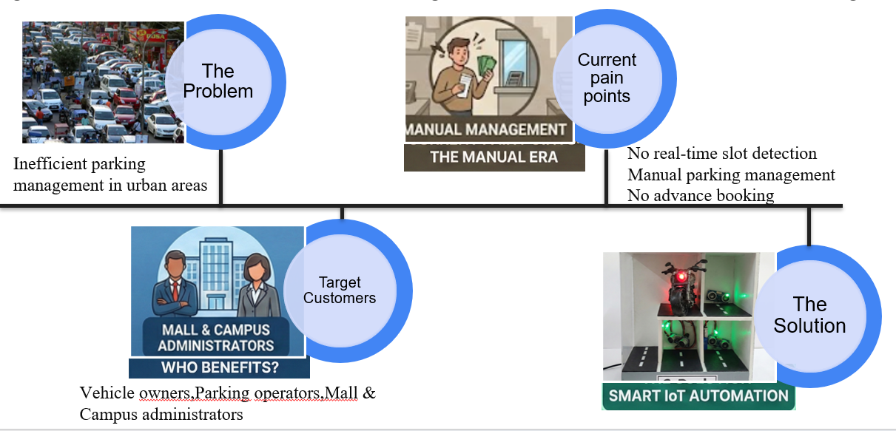
Innovation/Inventive step in the technology
Real-time slot detection using IoT sensors
Cloud-based live slot synchronization
Automatically cancels booking if vehicle not placed before three alerts.
Recommends new nearby empty slots if all slots in one place in full
Vehicle owners
Parking operators
Malls and campus administrators
Transition from per-slot sensor dependency to infrastructure-level intelligent sensing for large-scale deployment
Real-time slot state management (FREE–RESERVED–OCCUPIED) to eliminate double booking and inconsistencies

Slide 11
Applicable Regulations & Regulatory road map
Applicable Regulations
IT Act, 2000 (India):
Ensures secure handling of user data, online transactions, and digital communication.
Data Protection & Privacy Guidelines:
User information (mobile number, booking details, payment data) is stored securely with encrypted cloud communication.
Smart City Mission Guidelines (MoHUA):
Aligns with Government of India initiatives for smart mobility and intelligent infrastructure.
IoT & Wireless Communication Standards:
ESP32 and Wi-Fi modules comply with standard ISM band regulations.
Digital Payment Regulations (RBI):
UPI and digital payment gateways follow RBI guidelines for secure transactions.

Slide 12
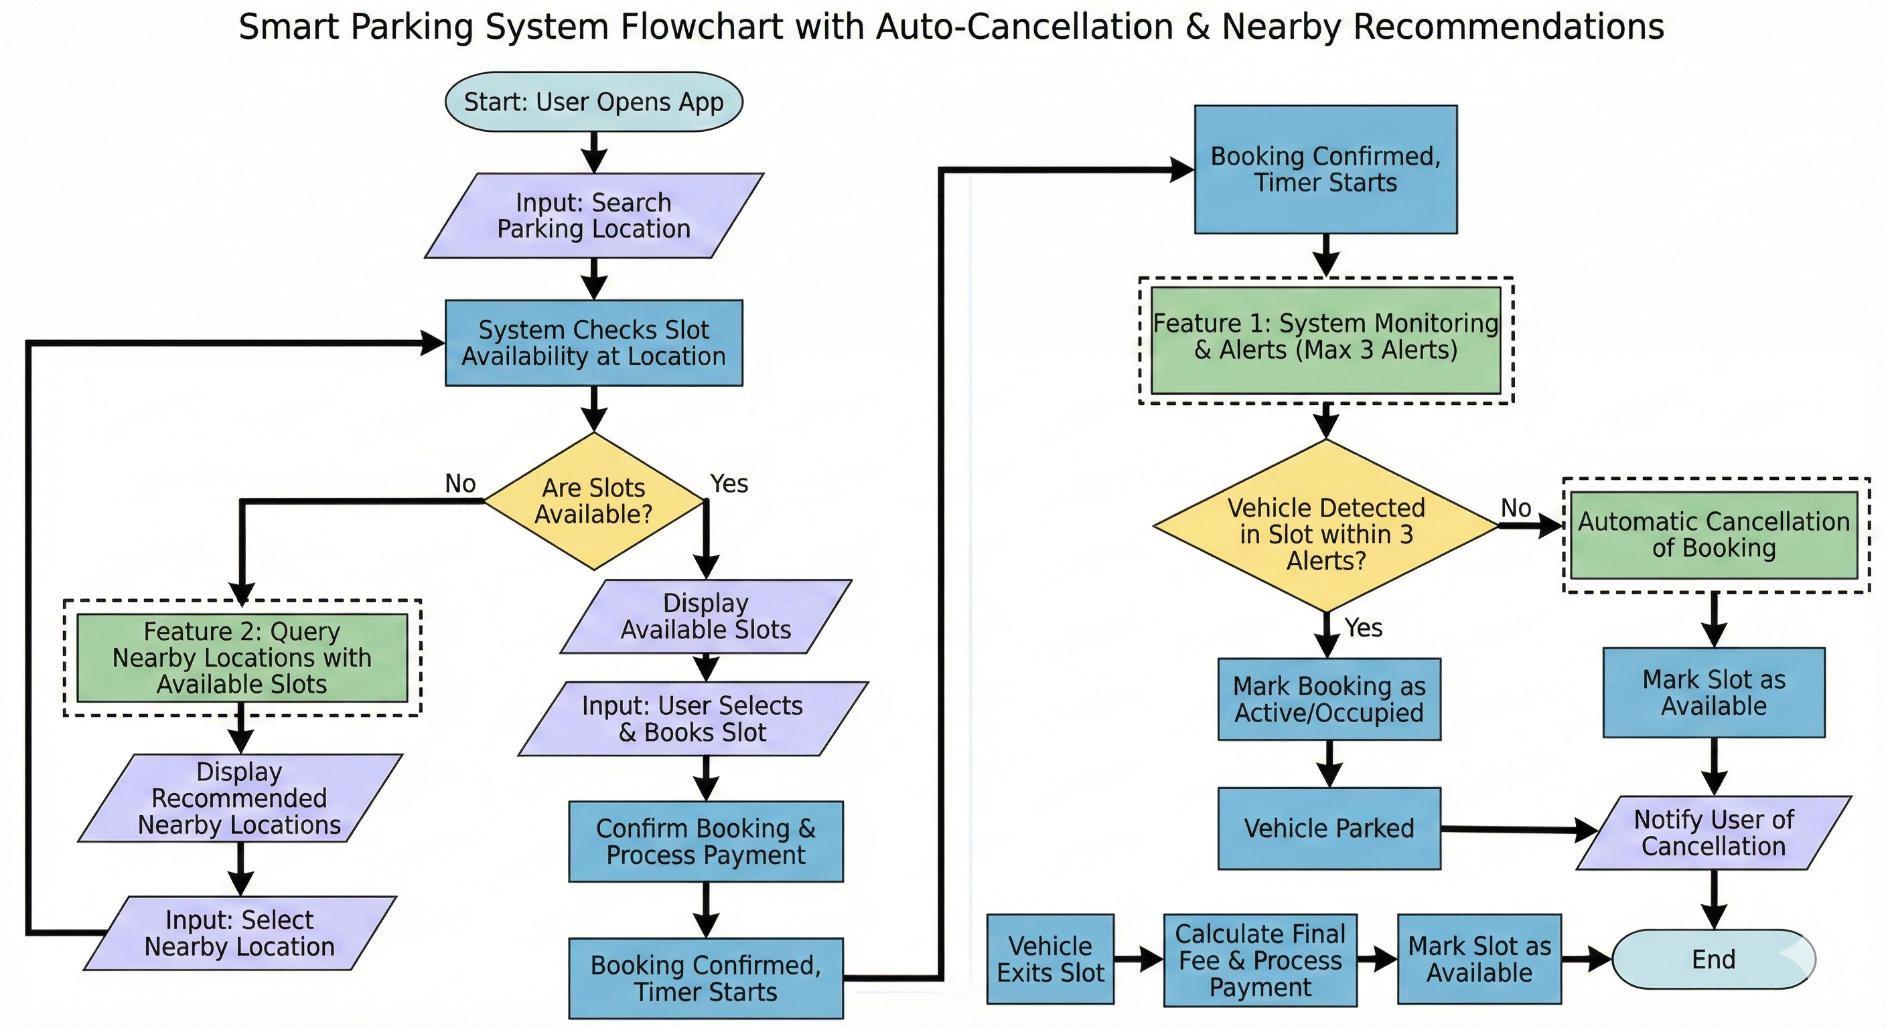
Regulatory Road Map
Search & Discovery: The user opens the app to search for a location, triggering an instant system check for real-time slot availability.
Intelligent Rerouting: If the primary location is full, the system automatically queries and recommends nearby alternatives; otherwise, it displays available slots.
Booking & Payment: The user selects a specific slot and completes the digital payment, which immediately starts a "validation timer" to secure the reservation.
Anti-Ghost Monitoring: Sensors monitor
the slot for vehicle arrival while the system
sends up to three alerts to ensure the
booking is genuine.
Auto-Cancellation Protocol: If the vehicle
is not detected after the third alert, the
system automatically cancels the booking to
free up the space for others.
Arrival Validation: Once the vehicle is
physically detected by the sensor, the system updates the booking status to "Occupied" and logs the entry
time.
Exit & Settlement: Upon vehicle exit, the sensors trigger the final fee calculation, process any remaining payment, and reset the slot status to "Available."

Slide 13
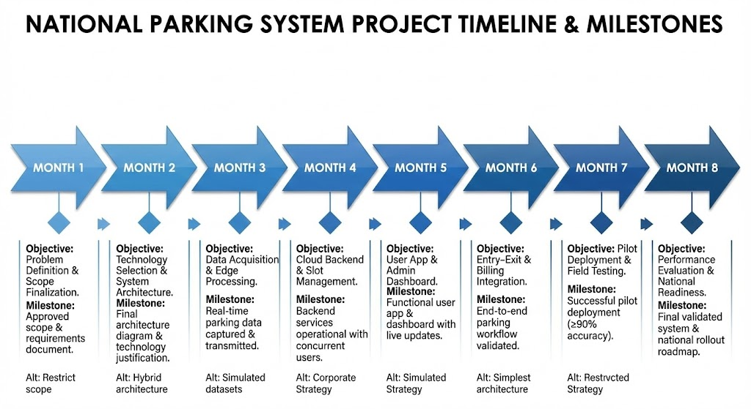
Objectives, activities, milestones and timelines
The project executes a structured 8-month roadmap, starting with Problem Definition and System Architecture (Months 1-2) to establish a robust technical foundation. The core development phase (Months 3-6) focuses on building the IoT sensor network, cloud backend, and mobile application, culminating in a fully integrated entry-exit billing system. The final stage (Months 7-8) is dedicated to Pilot Deployment and Field Validation, ensuring the system achieves ≥90% accuracy and operational stability before national-scale rollout.

